Slide 1
Medical history data
Project id: prsql – 02
Team ID : PTID-CDA-NOV-25-826
Presented By:
  Kaneshk P M
  Hari Prasanth S
  Rihaaf Tawbeeqa
  Gokul Krishnan B

Slide 2
Project objective
Understand patient demographics, medical history, and regional distribution through SQL
Use filtering, grouping, joins, formatting and calculations to extract insights.
Strengthen SQL query-writing skills in a real-world dataset context.

Slide 3
Database overview
Four main tables :
  patients
  admissions
  doctors
  province_names
Contains demographic, clinical, geographical, and doctor-specialty information.
Supports comprehensive relational analysis through JOINs and aggregation.

Slide 4
Data inspection
Used SELECT * queries across all tables to review raw records, validate table existence, and understand the initial structure and data volume.
Checked column names, data types, and relationships such as patient_id, province_id, and attending doctor_id to confirm how tables connect. Also inspected missing or NULL fields that might impact query results.
Ensured the dataset was consistent and complete enough for the 34 SQL operations by validating schema integrity, and identifying missing or NULL values.

Slide 5
Basic data retrieval
Queried male patients, patients without allergies, and first names starting with specific letters to understand dataset diversity.
Retrieved specific ranges (e.g. weight between 100-120 kg) to practice conditional filtering.
Generated readable output by constructing full names using CONCAT for presentation-friendly results.

Slide 6
Data cleaning & quality checks
Attempted to standardize allergy information by replacing NULL values with “NKA”, identifying write-permission limitations in the process.
Inspected missing fields to understand where data inconsistencies might affect later queries.
Highlighted the importance of preprocessing before performing analytical operations.

Slide 7
Join Operations across tables
Joined Patients with Province Names to display complete geographic information for each individual.
Connected Admissions with Patients to retrieve diagnosis-based details and identify disease occurrence patterns.
Used multi-table joins to extract cases such as dementia diagnoses and doctor involvement.

Slide 8
Aggregations & statistical queries
Counted patients by gender, birth year, and total admission count to build demographic summaries.
Leveraged SQL functions like COUNT(), YEAR(), and CASE to compute grouped statistics effectively.
These queries provided foundational metrics for trend analysis and dataset understanding.

Slide 9
Grouping with conditional logic
Retrieved first names appearing only once using GROUP BY and HAVING to detect uniqueness in the dataset.
Identified repeated admissions for the same diagnosis by grouping patient_id and diagnosis combinations.
Demonstrated SQL’s ability to highlight repetition, anomalies, and special-case patterns in the data.

Slide 10
Sorting & Text formatting
Ordered first name by character length and alphabetically to reveal distribution and structure of naming patterns.
Created formatted outputs like “LASTNAME,firstname” using UPPER(), LOWER() and CONCAT for report-ready display.
Improved readability and standardized text presentation for downstream usage.

Slide 11
Geographic data analysis
Extracted unique cities in the province “NS” to understand regional patient distribution.
Calculated total patient height per province and filtered results where height exceeded 7000 units.
Demonstrated how geographic identifiers add value to healthcare trend analysis.

Slide 12
Weight groups & bmi indicators
Grouped patients into 10-kg weight ranges to study overall weight distribution across the population.
Calculated BMI using height and weight marking patients as obese or non-obese based on standard medical criteria.
Showcased the usefulness of derived metrics in health-based decision-making.

Slide 13
Time & date-based analytics
Evaluated admissions frequency by day of the month to detect peak hospital visit periods.
Identified patients born between 1970 – 1979 and sorted them chronologically for generational insights.
Used DATE functions to highlight patterns and behaviours across time-based data.

Slide 14
Combined entity analysis
Merged doctor and patient lists using UNION ALL while labelling roles to show workforce vs patient distribution.
Retrieved cases where epilepsy diagnoses were specifically handled by Dr. Lisa through JOIN operations.
Illustrated precise filtering in multi-criteria scenarios using combined relational logic.

Slide 15
SQL queries

Slide 16
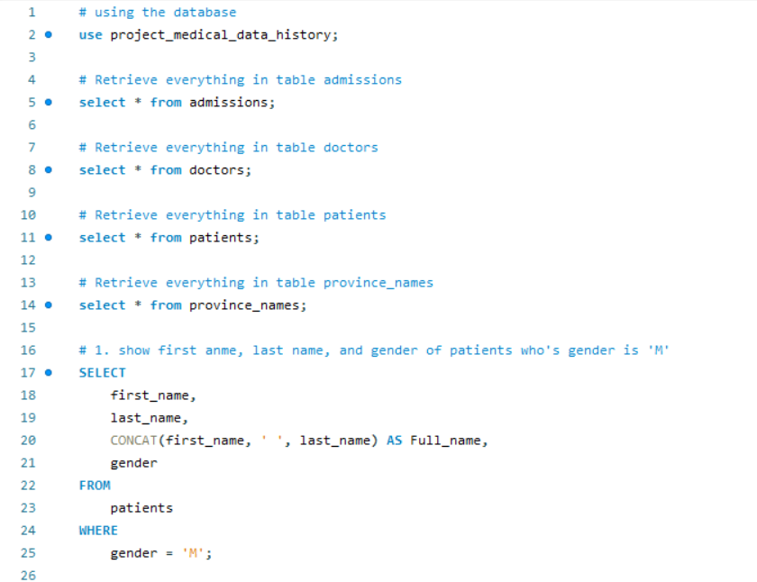

Slide 17
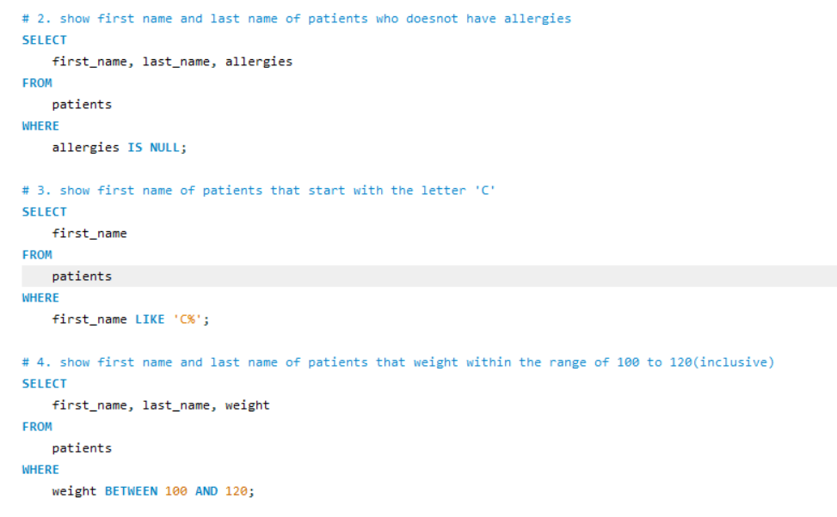

Slide 18
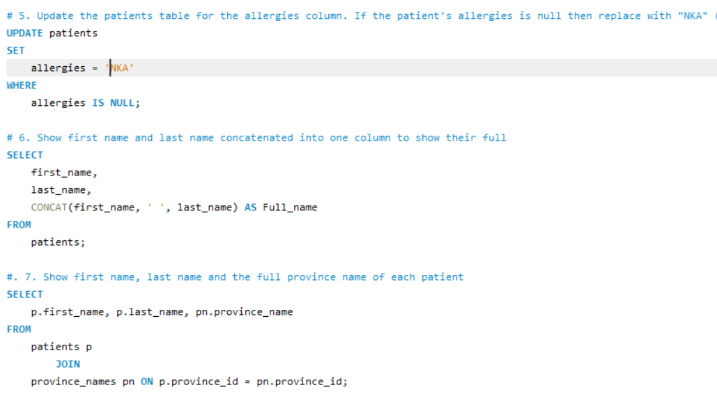

Slide 19
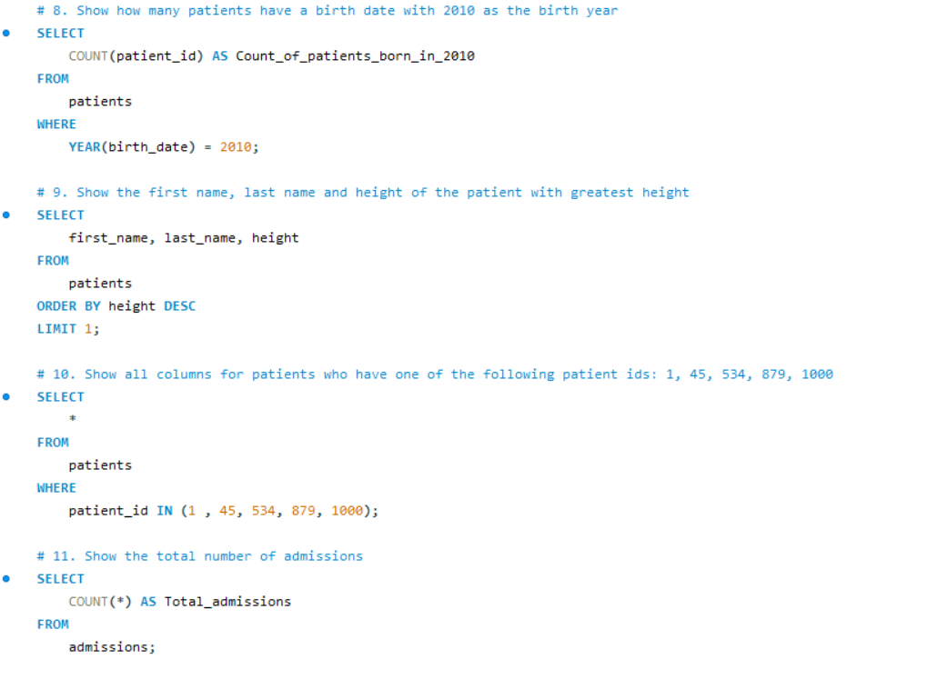

Slide 20
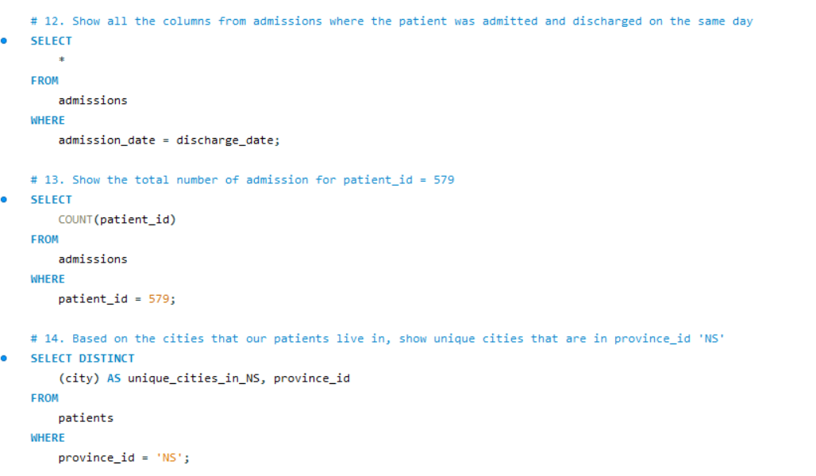

Slide 21
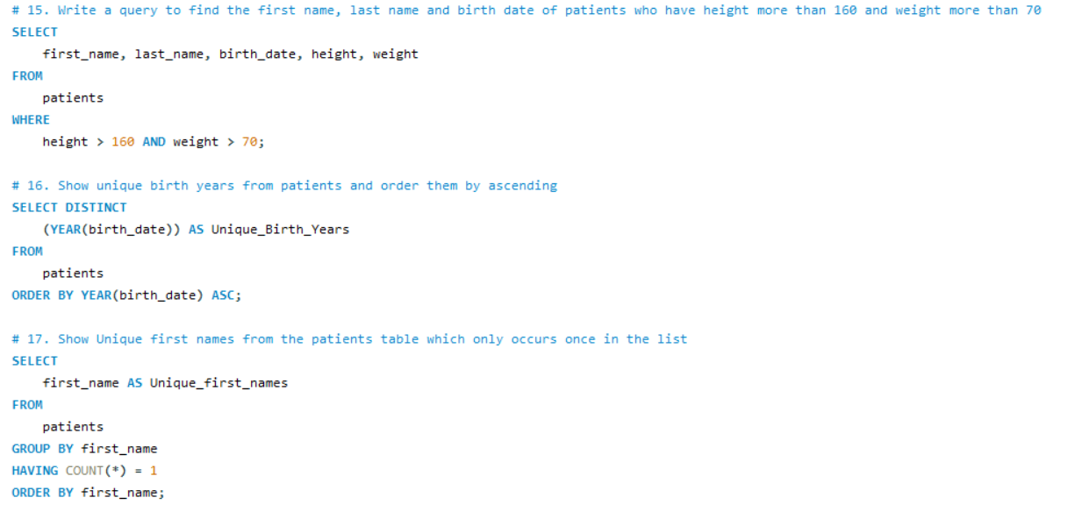

Slide 22
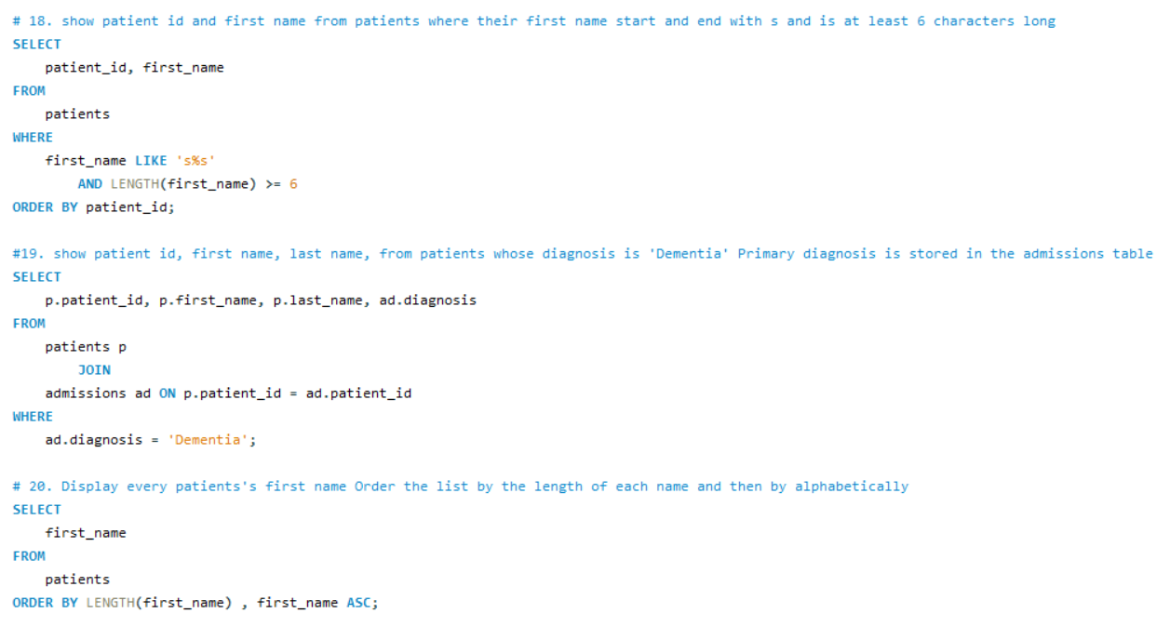

Slide 23
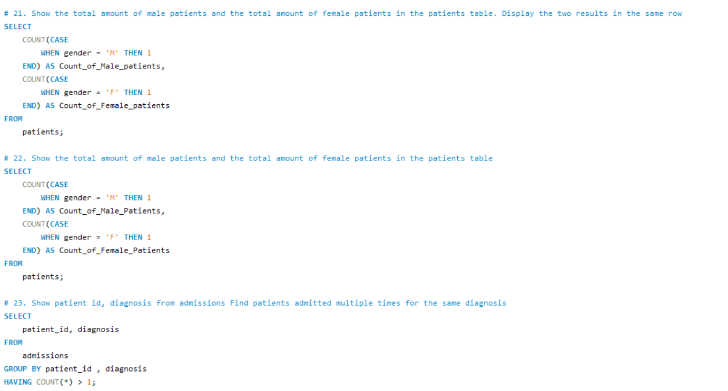

Slide 24
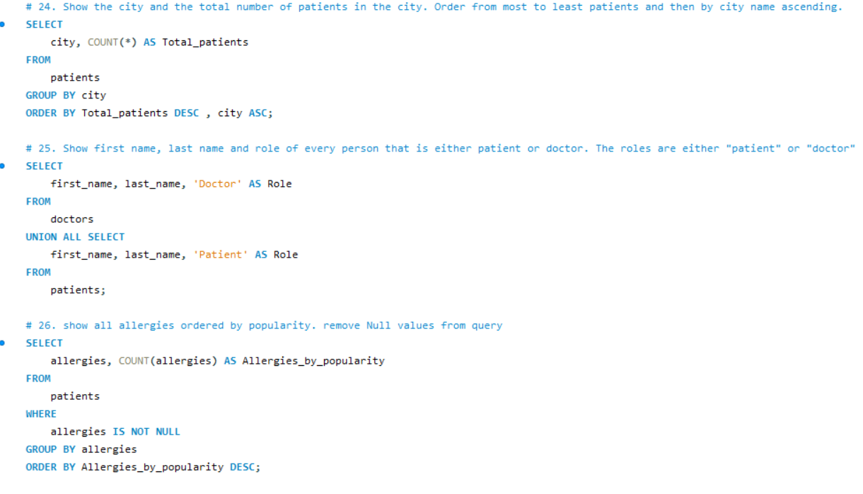

Slide 25
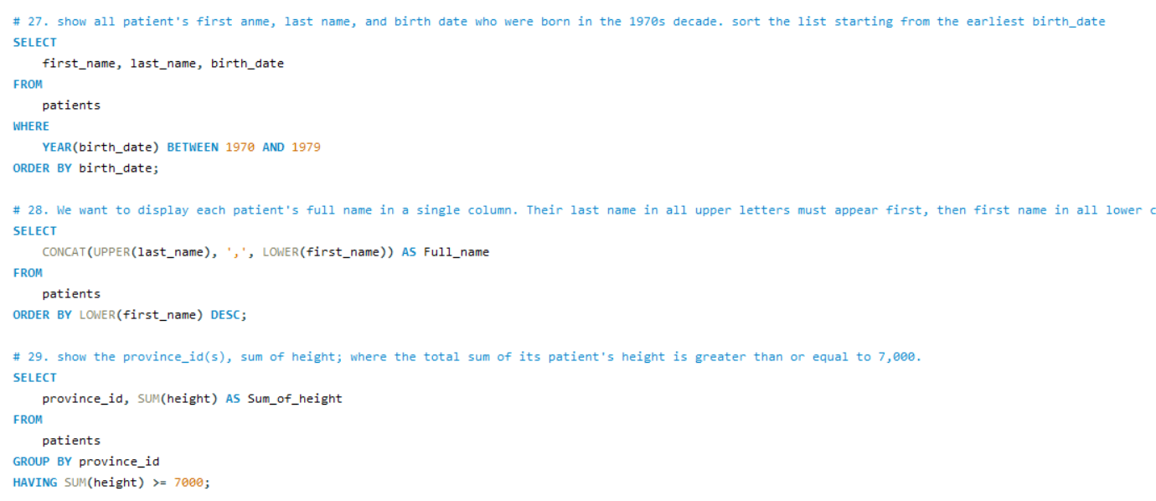

Slide 26
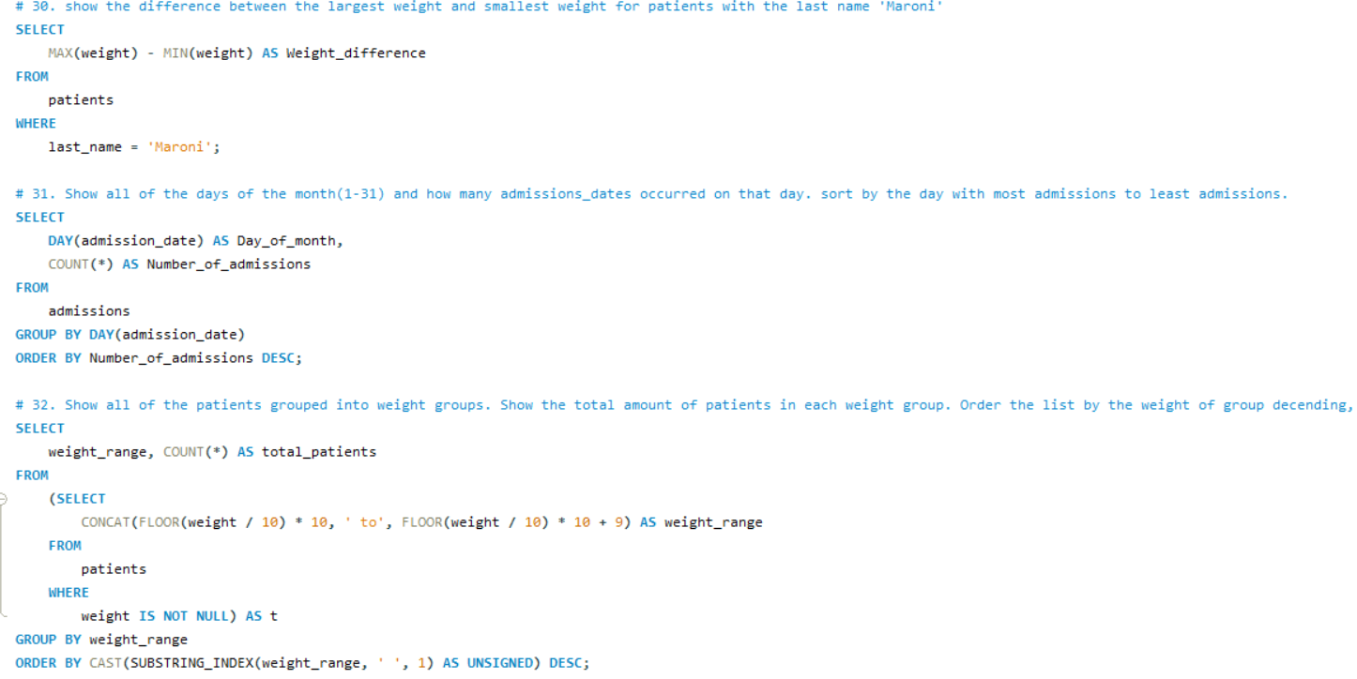

Slide 27
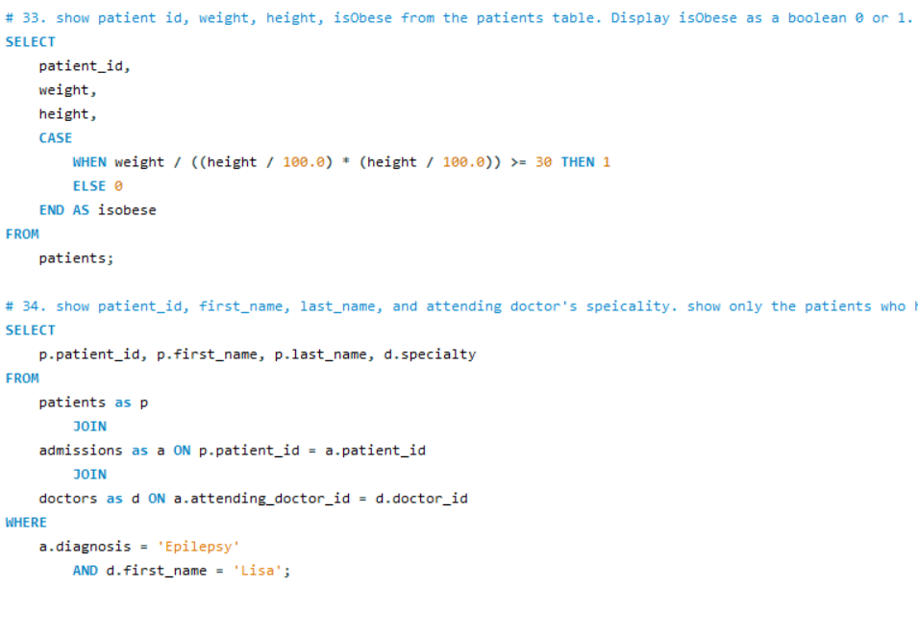

Slide 28
Final outcomes & learning
Successfully executed 34 SQL queries covering filtering, joins, grouping, formatting, date operations, and analysis.
Extracted key health insights: demographic patterns, admission trends, weight/BMI insights, and province-based summaries.
Improved SQL expertise, learned optimization techniques and built a foundation for advanced reporting and visualization.

